Slide 1
Discovering the Universe of 2022 Forbes Billionaires: Unveiling the Billionaire Galaxies
Introduction:
We will be going through the Forbes Billionaires Universe for 2022, delving into the fascinating world of the world's richest individuals. This in-depth examination of the exclusive Forbes Billionaires List provides a thorough look at the 2,600 billionaires who epitomize affluent achievement.
This journey navigates through their dynamic world, revealing the intriguing patterns among these super-rich stars. Discover the startling connections an interplay on how age, industry, and location interact to trace the genesis of these enormous riches. Find out what drives the enormous riches of these people, from computer titans to real estate tycoons. This presentation invites you to uncover hidden insights and surprising connections within the billionaire galaxy.

Slide 2
Key Questions to Explore
Who are the wealthiest individuals on the planet?
What industries and countries dominate the billionaire landscape?
How does age influence net worth accumulation?
What are the primary sources fuelling the billionaire fortunes?
Data Source:
Data sourced from the prestigious Forbes Billionaires List of 2022
The dataset comprise about 2,600 billionaires worldwide in 2022
The key attributes include rank, name, net worth, age, country, source, and industry
Data Source:
Data imported into Power BI for analysis
Handled data inconsistencies
Standardized formatting and data types

Slide 3

Unveiling the Billionaire Galaxies
The following shows the metrics for the 2022 Forbes Billionaires
The total number of billionaires for 2022 is 2600, with a total networth of Twelve Trillion Six Hundred and Forty Billion Dollar only ($12.64 Trillon) Across 75 Countries and a total of 18 Industry Sectors

Slide 4
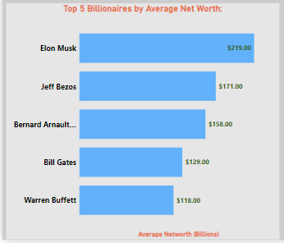
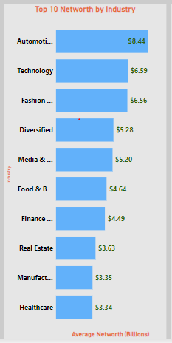
Data Analysis – findings and insights:
Top Billionaires: By Categories
The Top 5 Billionaires by Names has Elon Musk as number 1, followed by Jeff Bezos, Bernard Arnault, Bill Gates, and Warren Buffet respectively, While the with the Top 10 industries are Automobile, Technology, Fashion, Diversified, Media, Food & Beverages, Finance, Real estate, Manufacturing and Healthcare respectively

Slide 5
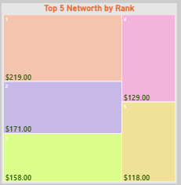
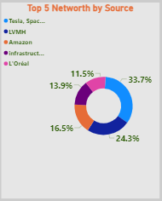
Top Billionaires: By different Categories
The Top 5 Billionaires by Rank has $219 Billion ranking as number 1, followed by $171, $158, $129, and $118 Billion Dollars respectively with the Top five net worth coming from Tesla, Space X, LVMH, Amazon, Infrastructure, and L'Oréal Respectively

Slide 6
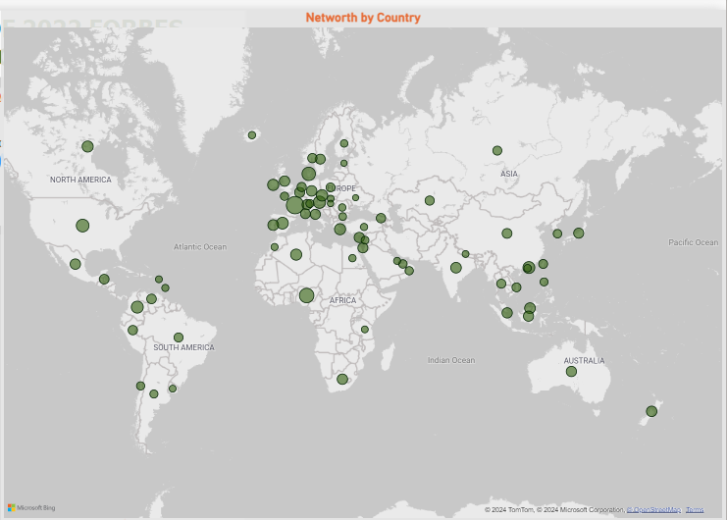
Geographic Distribution of Billionaires
The Distribution of billionaires by countries and continent has Europe with the highest number of billionaires followed by Asia, South America, North America, Africa and the Pacific Respectively.

Slide 7
Recommendations:
Based on the analysis presented on the 2022 Forbes Billionaires dataset, the following recommendations are made:
Leverage industry insights to identify drivers of wealth accumulation and potential investment opportunities.
Explore geographic hotspots to understand conducive economic, political, and cultural factors for fostering wealth creation.
Analyze age trends to gain lessons on wealth-building strategies across different life stages.
Investigate sources of wealth to uncover key factors driving wealth creation and inform investment and business strategies.
Embrace data-driven decision-making by investing in robust data analytics capabilities and fostering a data-driven culture.
Foster collaboration and knowledge sharing among stakeholders, policymakers, and industry leaders to stimulate innovation and promote sustainable economic growth.
By implementing these recommendations, organizations and individuals can gain a competitive edge, make well-informed decisions, and position themselves for sustainable success(wealth creation, strategic decision-making, and sustainable growth) in the ever-evolving business landscape.

Slide 8
Conclusion:
The Forbes Billionaires dataset of 2022 offers a captivating glimpse into the realm of extreme wealth of individuals.
This analysis serves as a launchpad for further exploration and strategic decision-making where necessary.
Embrace the power of the available data used to navigate the ever-evolving billionaire cosmos in the year 2022.
By presenting the above analysis in this engaging and visually compelling guide, a comprehensive understanding of the billionaire landscape, as revealed by the 2022 Forbes Billionaires has been unveiled.

